Slide 1

ADDIS ABABA INSTITUTE OF TECHNOLOGY
Center of Information Technology and Scientific Computing
Department of Software Engineering
Real Estate Management System
Industrial Project Presentation Group Members:-
Nebyou Ameneshewa
Ermias Asheber
Tinsae Tesfaye
Date Sep 28, 2021

Slide 2
Outline
Overview
Objective Of the Project
Scope of project
Use Case
Class Diagram
Implementation tool
Demo

Slide 3
Overview
The real estate market is a booming industry. Real estate is a type of business for selling, buying, renting land, buildings and offices. The success of the industry is a result of competition and the intervention of modern technology. Most people in the business prefer to use real estate management system to stay ahead in the race. Real estate property management software is an effective and easy-to-use tool. It facilitates the management of properties personal property, equipment, including maintenance all through a single piece of software.
Initially, the overall real estate process now is a manual system where The real estate agency follows a lengthy and hectic process. With this manual system, few buyers and sellers can be contacted at a time. And people meet the agent in person, for checking the Property details and also needs to visit the location. After finding the desired place and too many processes of paper works has been done, the customer will finally rent the place. If a customer wants to update the details of his property, he should contact the agent or visit office.

Slide 4
Objective Of the Project
General Objective
The overall objective is to automate the manual work that is done by the Real Estate to eliminate the problems and gaps that occurs among the Clients and the Real Estate Corporate.
Specific Objectives
To achieve the general objective, the following specific objectives must be accomplished:
Collect data and requirements
Observe how the current system works
Interview Consumers and determine their desires
Analyze drawbacks of the current system
Propose a system that modifies the current system
Deploy the proposed system
Work in a team to make sure the system achieves its goal

Slide 5
Scope of the Project
The RSM is designed to meet the needs of peoples who wants to rent the prefect house without any ups and downs and also the real estate’s landlords who wants their house to be rented without any extra process and also with a short period of time. The system has features such as:
Rental contract for clients
Housing promotion
House information
Adding Houses that are available
Registering Manager
Authentication/Authorization for users
One of the limitations of this system is, it may not provide the payment options that buyers want, and need, to accommodate their lifestyle demands.

Slide 6
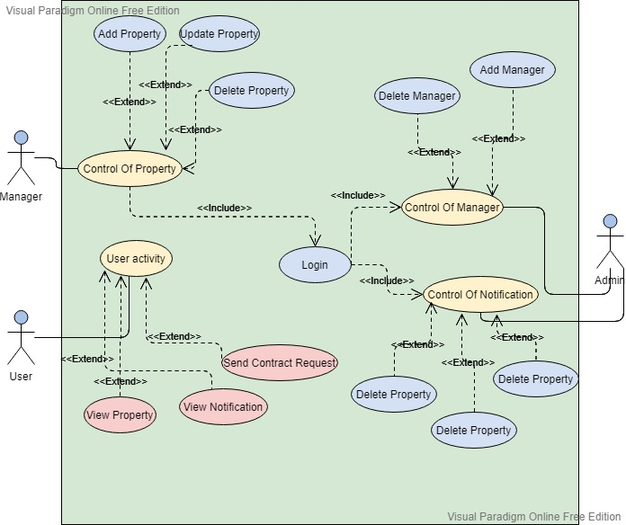
Use Case

Slide 7
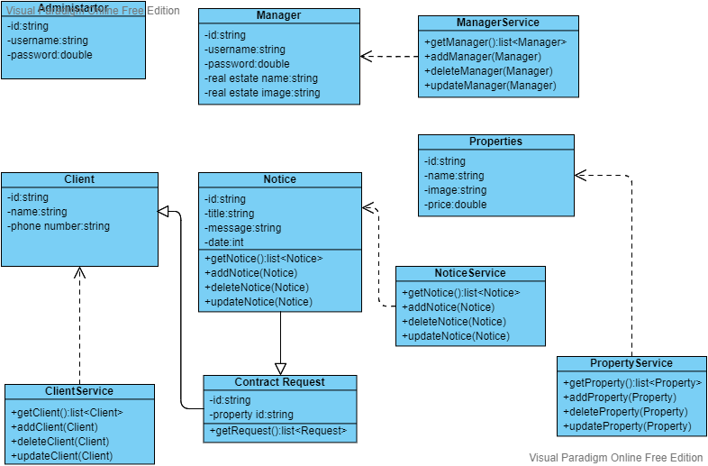
Class Diagram

Slide 8
Implementation Tools
Hardware Interfaces
The system requires any devices that enables Clients to browse to the website such as smart phone, tablet, desktop.
Software Interfaces
The Real Estate Management System is reliant on a Browser which means each actors (admin, manager and client) need to use any browser such as Chrome, Safari, Edge, and Firefox. The front-end and back-end frameworks are basic HTML, CSS and Golang, respectively. The database will be an SQLite.
Communications Interfaces
Since the system will be delivered as a Web. The system will use HTTPS Rest API for all communication on the internet.

Slide 9
Demo
Demonstration of The System!!!!!!!!!!!

